Slide 1
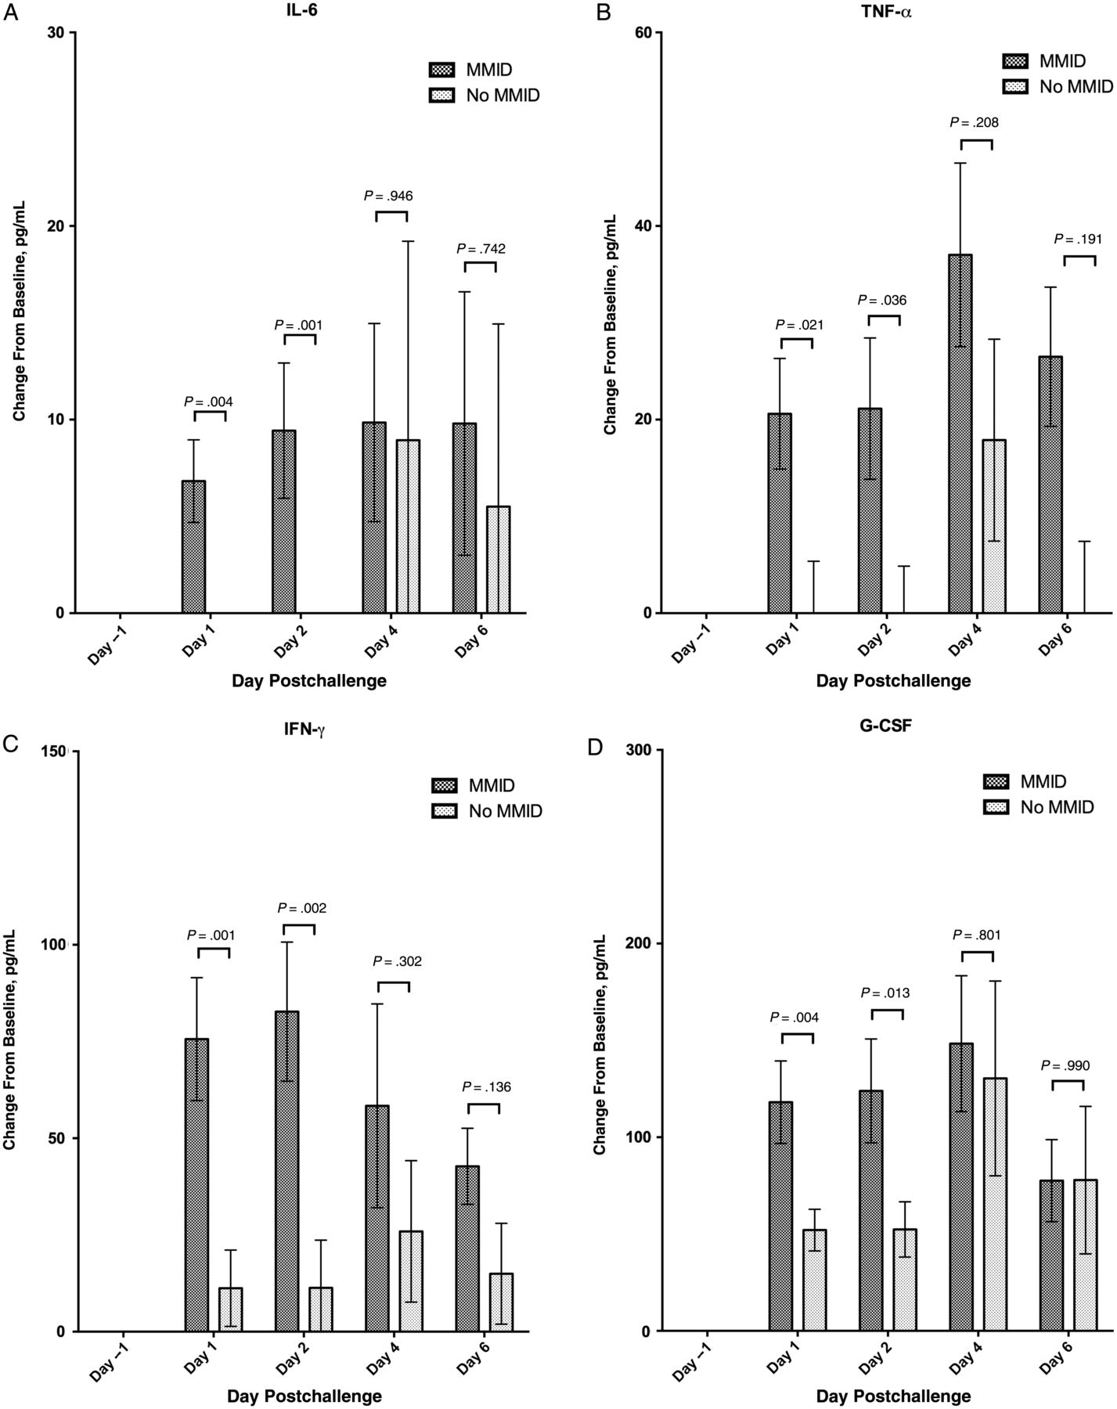

Figure 4. Cytokine response. Mean rise in interleukin 6 (IL-6), tumor necrosis factor alpha (TNF-α), interferon gamma ...
Notes:
Figure 4. Cytokine response. Mean rise in interleukin 6 (IL-6), tumor necrosis factor alpha (TNF-α), interferon gamma (IFN-γ), and granulocyte colony-stimulating factor (G-CSF) in all participants both pre- and postchallenge, separated by those who met criteria for mild to moderate influenza disease (MMID), and those who did not (± standard error of the mean [SEM]). Significance is noted by P value between MMID and no MMID by day.
Unless provided in the caption above, the following copyright applies to the content of this slide: Published by Oxford University Press on behalf of the Infectious Diseases Society of America 2014. This work is written by (a) US Government employee(s) and is in the public domain in the US.

